Slide 1
Sensor Data Analysis
By Yaohang Li, Ph.D. Department of Computer Science Old Dominion University yaohang@cs.odu.edu

Slide 2
Agenda
Characteristics of Sensor Data
1D-CNN for Sensor Data as Time Series
Sensor Data Denoising
Recover Missing Sensor Data
LiDAR and Point Cloud
Summary

Slide 3
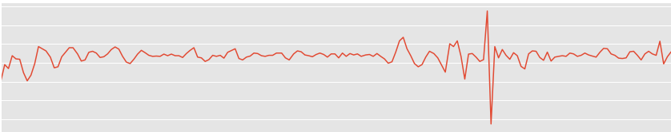
Sensor Data
Huge volumes of data
Mostly unlabeled
Complex data with non-trivial patterns
Mostly temporal
Variety of data representations
Manual feature engineering is hard
Multiple modalities
Time series
Most sensor data is time series

Slide 4
Agenda
Characteristics of Sensor Data
1D-CNN for Sensor Data as Time Series
Sensor Data Denoising
Recover Missing Sensor Data
LiDAR and Point Cloud
Summary

Slide 5
1D-CNN
Advantages of 1D-CNN
Effective in deriving features from short, fixed length segments of data
Pick up pattern over a period of time
Location of the feature within the segment is not highly relevant
Applications
Analysis of time sequences of sensor data
Signal data over a fixed-length period
Natural Language Processing

Slide 6
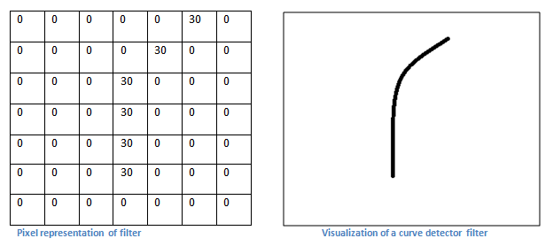
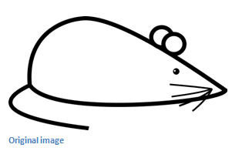
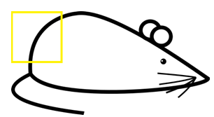
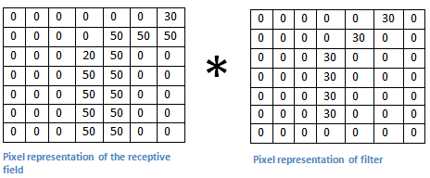

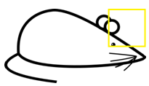
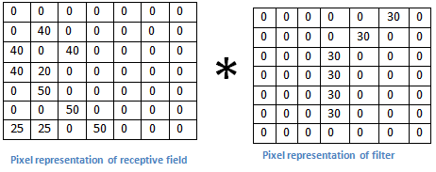
Try to remember: Convolution Operation
Kernel
*
=
= 6600
(Big Number)
*
=
= 0
(Small
Number)
Image from Stanford CS231N

Slide 7
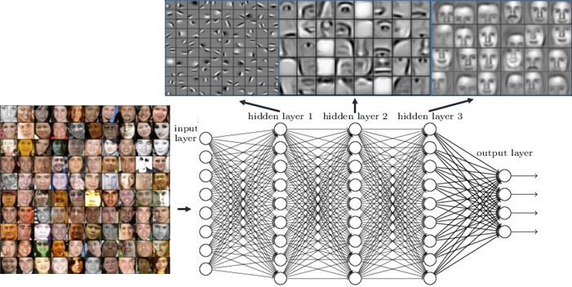
Feature Extractions from CNN
2D CNN
Layer
2D CNN
Layer
2D CNN
Layer

Slide 8
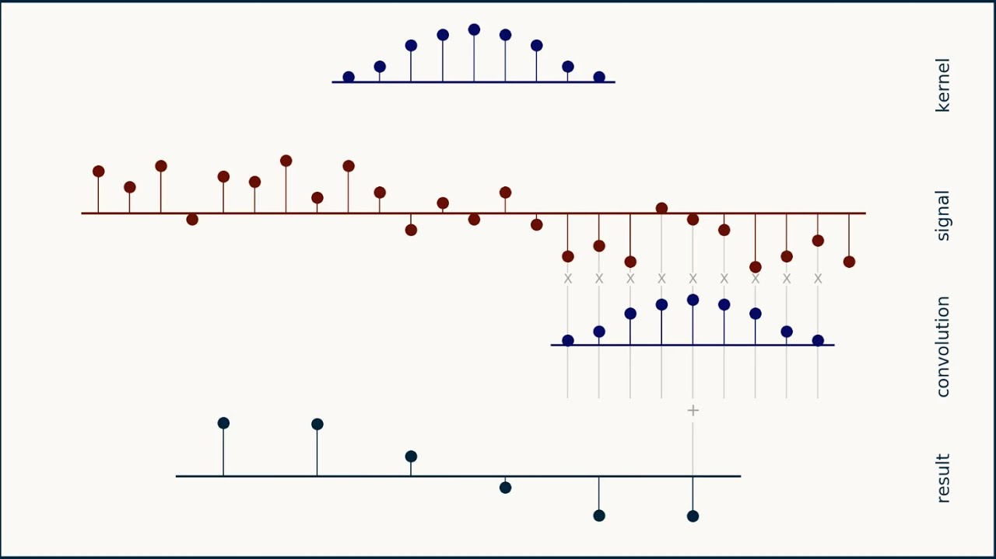
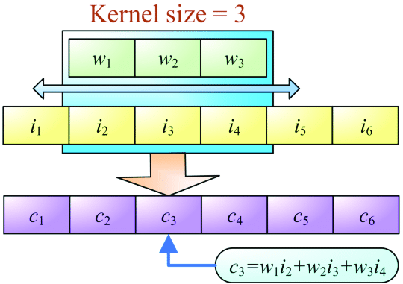
1-D Convolution
Calculations-involved-in-a-1D-convolution-operation, Analytics Vidhya

Slide 9
1D-CNN Architecture

Slide 10
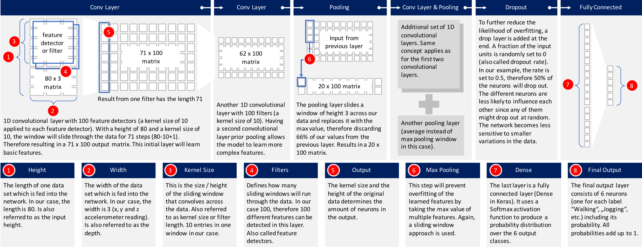
Understanding 1D-CNN
Image source: Introduction to 1D Convolutional Neural Networks in Keras for Time Sequences by Nils Ackermann
 | model_m = Sequential() model_m.add(Reshape((TIME_PERIODS, num_sensors), input_shape=(input_shape,)))
 | model_m.add(Conv1D(100, 10, activation='relu', input_shape=(TIME_PERIODS, num_sensors)))
 | model_m.add(Conv1D(100, 10, activation='relu'))
 | model_m.add(MaxPooling1D(3))
 | model_m.add(Conv1D(160, 10, activation='relu'))
 | model_m.add(Conv1D(160, 10, activation='relu'))
 | model_m.add(GlobalAveragePooling1D())
 | model_m.add(Dropout(0.5))
 | model_m.add(Dense(num_classes, activation='softmax'))

Slide 11
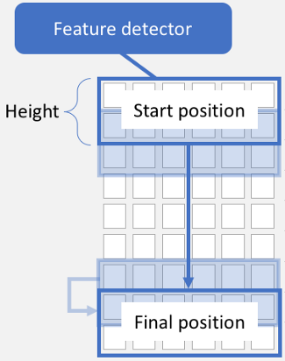
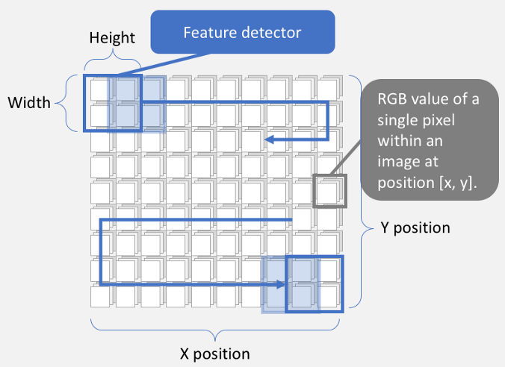
1D-CNN vs. 2D-CNN
1D-CNN
2D-CNN
Feature vector
Image source: Introduction to 1D Convolutional Neural Networks in Keras for Time Sequences by Nils Ackermann

Slide 12
1D-CNN vs. RNN
Both can be effectively used for handling time series data
1D-CNN
Fixed Length sequence
Much faster in training
Better performance
RNN
Data with variate/unknown lengths
Sentences in natural language processing

Slide 13
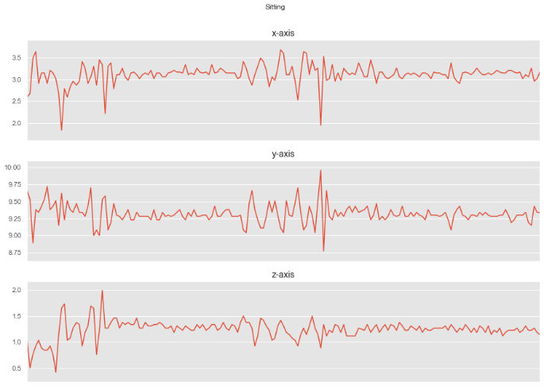
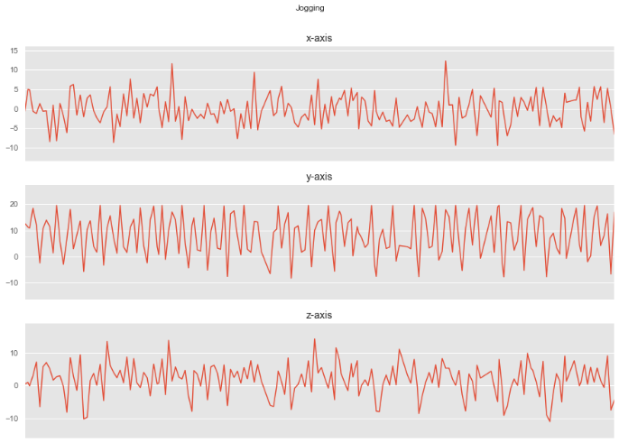
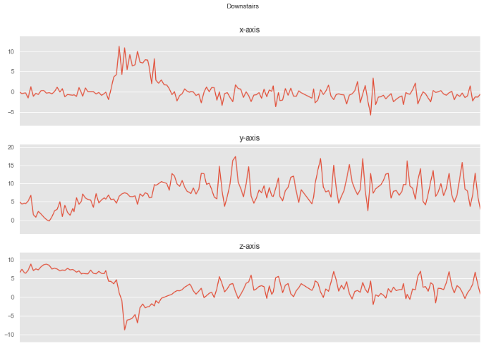
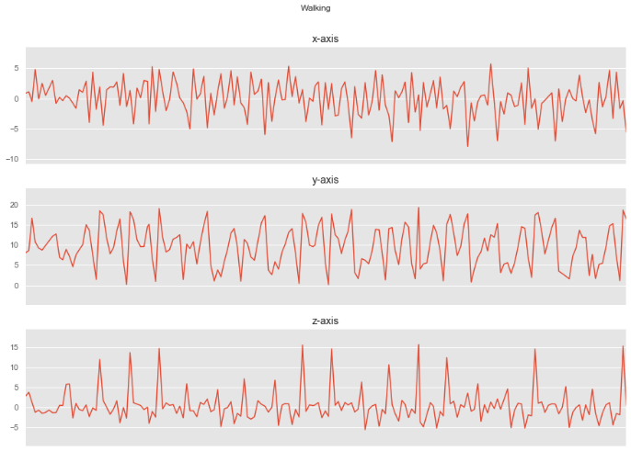
Demo: 1D-CNN for activity recognition
Jupyter notebook 1DCNN.ipynb

Slide 14
Real-time Electrocardiogram (ECG) Monitoring
Arrhythmia Detection and Identification System
S. Kiranyaz, T. Ince, M. Gabbouj, “Real-Time Patient Specific ECG Classification by 1D Convolutional Neural Networks”, IEEE Trans. on Biomedical Engineering, vol. 63, no. 3, pp. 664-675, Mar 2016.

Slide 15
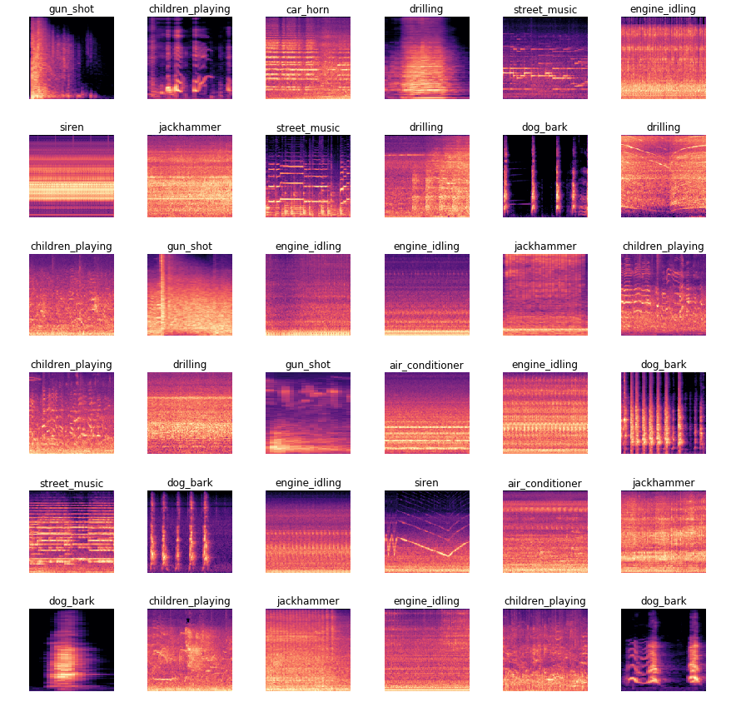
Environmental Sound Classification
Spectrogram
1D-CNN can achieve 82% accuracy in classifying environmental sound signals.
Sajjad Abdoli, Patrick Cardinal, Alessandro Lameiras Koerich, End-to-End Environmental Sound Classification using a 1D Convolutional Neural Network, arXiv:1904.08990, 2019.

Slide 16
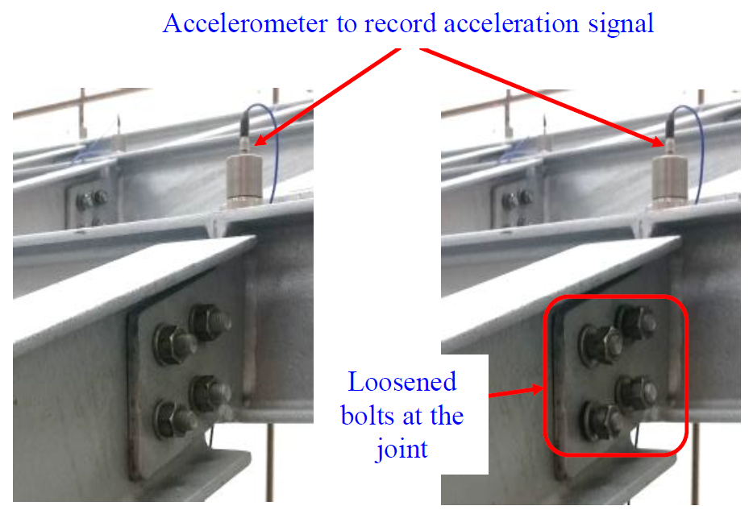
Structure Health Monitoring and Damage Detection
Normal
Loosened
M.S.O. Abdeljaber, O. Avci, S. Kiranyaz, H. Sodano, D. J. Inman, “1-D CNNs for Structural Damage Detection: Verification on a Structural Health Monitoring Benchmark Data”, Neurocomputing, 275: 1308 – 1317, 2018.

Slide 17
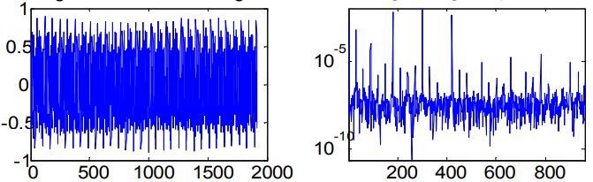
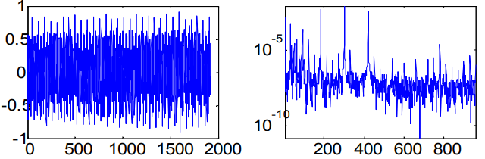
Real-Time Motor Condition Monitoring
Healthy Signal
Faulty Signal
L. Eren, “Bearing fault detection by one-dimensional convolutional neural networks,” Math. Probl. Eng., doi:10.1155/2017/8617315, 2017.

Slide 18
Agenda
Characteristics of Sensor Data
1D-CNN for Sensor Data as Time Series
Sensor Data Denoising
Recover Missing Sensor Data
LiDAR and Point Cloud
Summary

Slide 19
Denoising
Noise
Random, signal-independent noise
Signal-dependent noise
Denoising
Process of removing noise from signals
Aims
Noise Reduction
Feature preservation

Slide 20
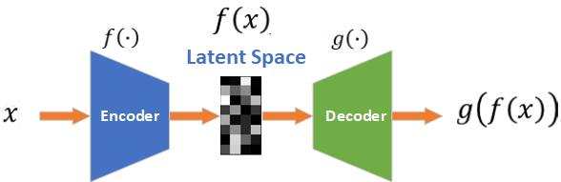
Denoising Autoencoder
Autoencoder
Mimic an identity function
Denoising Autoencoder
Receive noisy data as input
Predict the original data as output

Slide 21
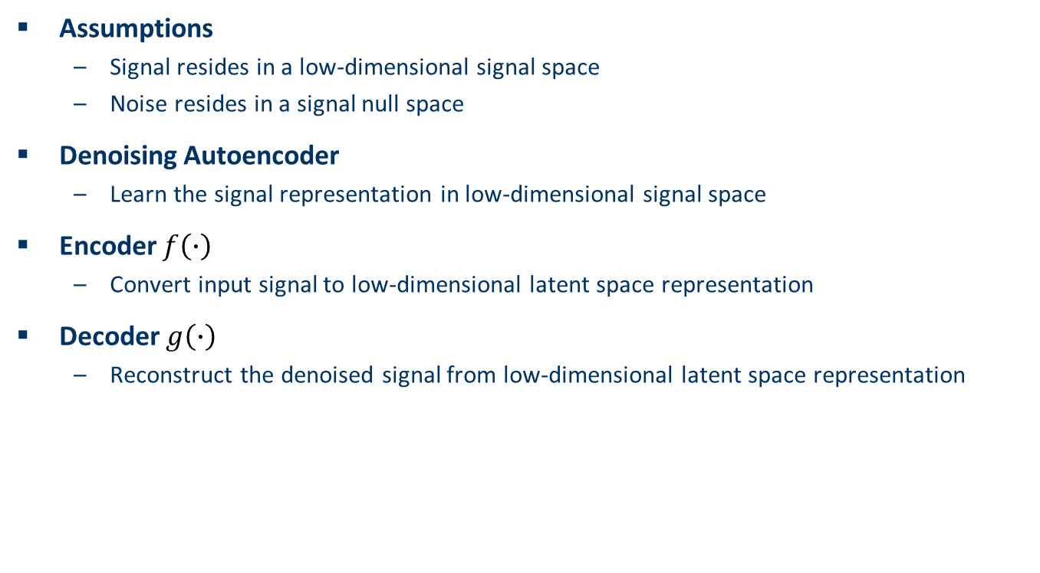
Denoising Autoencoder Mechanism
Assumptions
Signal resides in a low-dimensional signal space
Noise resides in a signal null space
Denoising Autoencoder
Learn the signal representation in low-dimensional signal space
Encoder $f\left(∙\right)$
Convert input signal to low-dimensional latent space representation
Decoder $g\left(∙\right)$
Reconstruct the denoised signal from low-dimensional latent space representation

Slide 22
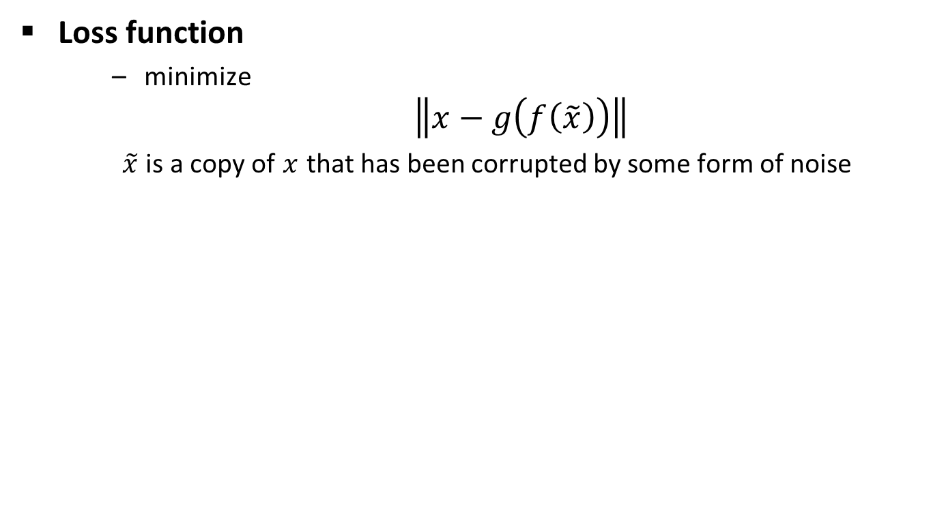
Denoising Autoencoder Loss
Loss function
minimize $\left\|x−g\left(f\left(\tilde{x}\right)\right)\right\|$
$\tilde{x}$ is a copy of $x$ that has been corrupted by some form of noise

Slide 23

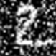

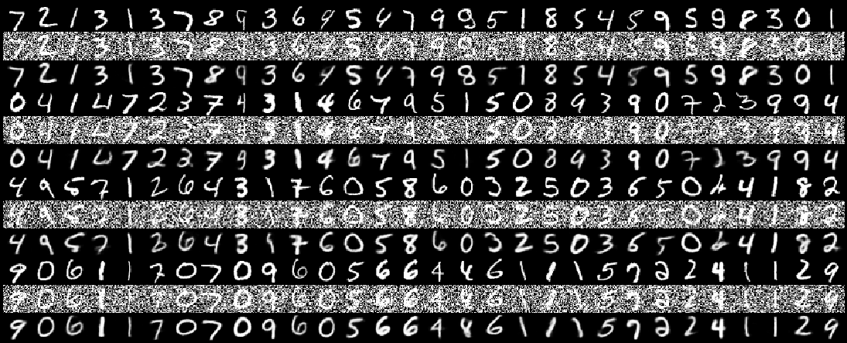
Denoising Image Noise
Encoder
Decoder
Noisy Input
Latent Space Representation
Denoised Input

Slide 24
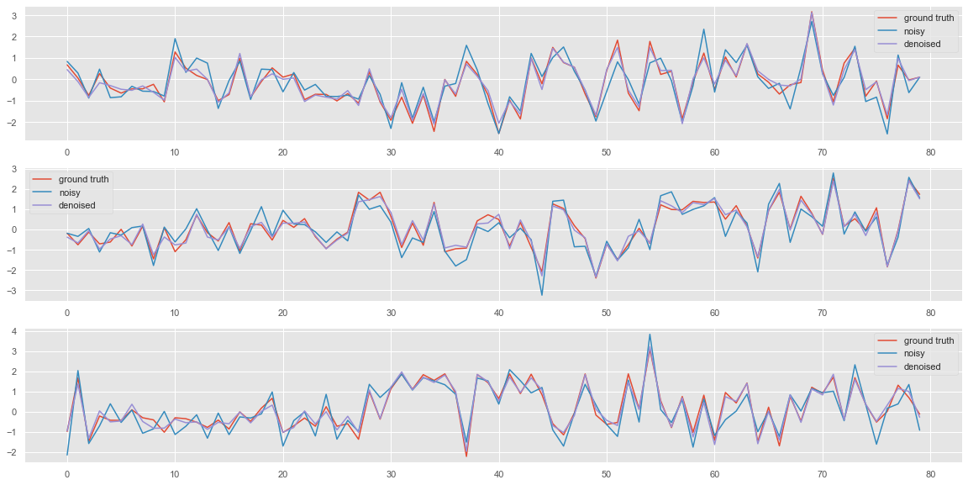
Demo: Denoising Sensor Data
Jupyter notebook denoising.ipynb

Slide 25
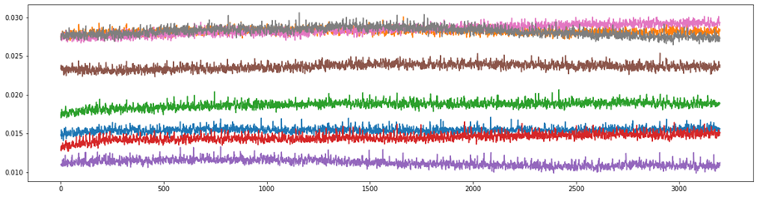
Sensor Drift Problem
A set of sensors monitoring a field of interest in long term
Sensor Drift
Low frequency change over time
Electronic aging
Pressure change
Substructure change
Deformation of plastic components
Over-heating of the battery
Inaccurate measurement reading
Calibration
Needed from time to time against the ground truth

Slide 26
Blind Drift Calibration
Calibration of Deployed Sensors
Unmount and recalibrate
Time consuming
A lot of manpower
High maintenance cost
Blind Drift Calibration
Calibrating sensors without ground truth

Slide 27
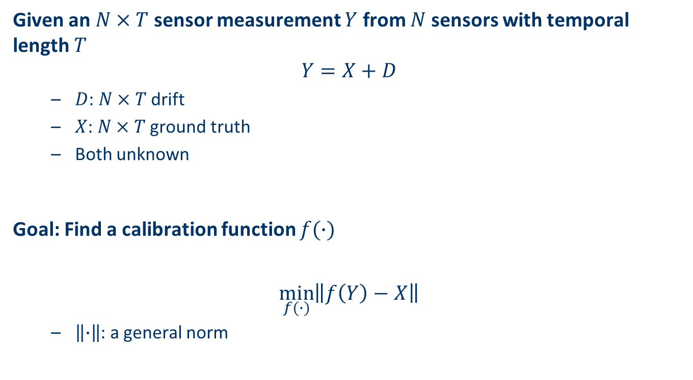
Formulation of the Blind Calibration Problem
Given an $N×T$ sensor measurement $Y$ from $N$ sensors with temporal length $T$
$$Y=X+D$$
$D$: $N×T$ drift
$X$: $N×T$ ground truth
Both unknown
Goal: Find a calibration function $f(∙)$
$$\min_{f(∙)}\left\|f\left(Y\right)−X\right\|$$
$\left\|∙\right\|$: a general norm

Slide 28
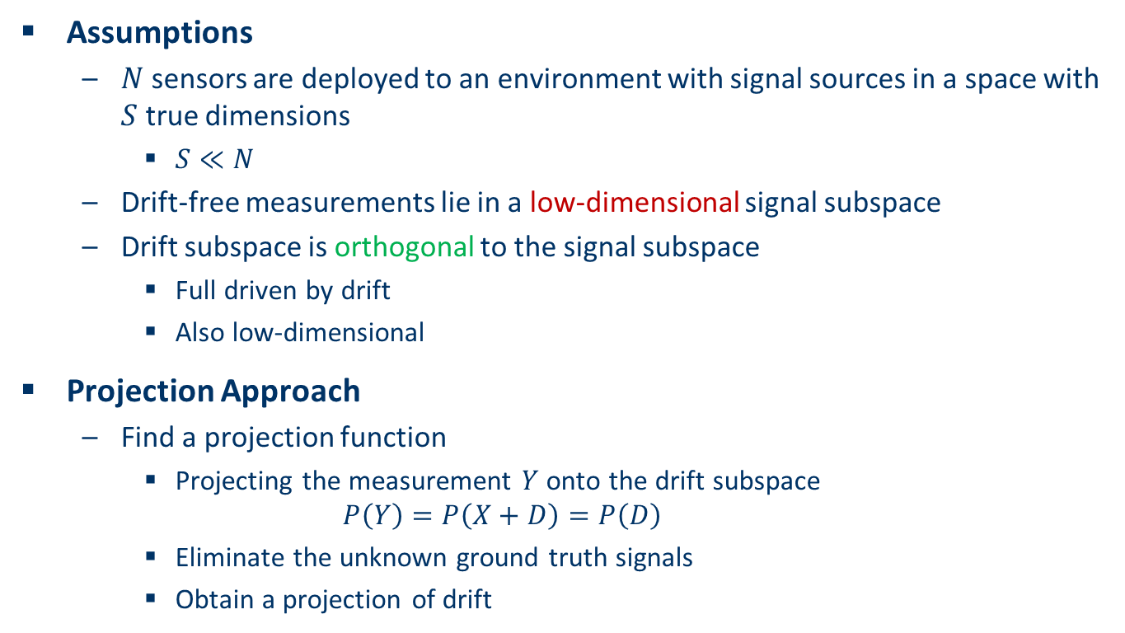
Projection Approach of Blind Drift Calibration
Assumptions
$N$ sensors are deployed to an environment with signal sources in a space with $S$ true dimensions
$S≪N$
Drift-free measurements lie in a low-dimensional signal subspace
Drift subspace is orthogonal to the signal subspace
Full driven by drift
Also low-dimensional
Projection Approach
Find a projection function
Projecting the measurement $Y$ onto the drift subspace
$$P\left(Y\right)=P\left(X+D\right)=P\left(D\right)$$
Eliminate the unknown ground truth signals
Obtain a projection of drift

Slide 29
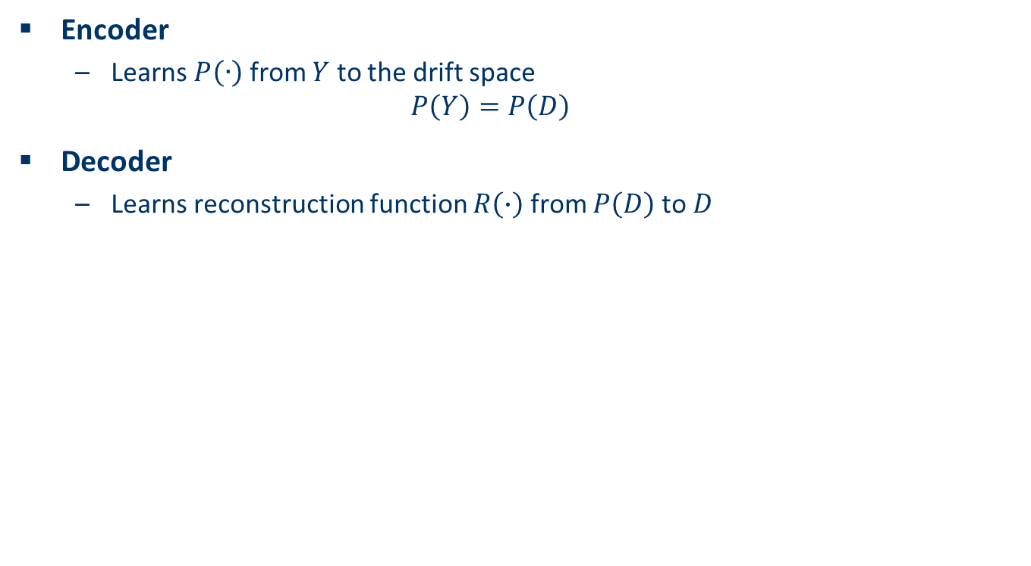
Blind Drift Calibration Autoencoder
Encoder
Learns $P\left(∙\right)$ from $Y$ to the drift space
$$P\left(Y\right)=P\left(D\right)$$
Decoder
Learns reconstruction function $R\left(∙\right)$ from $P\left(D\right)$ to $D$

Slide 30
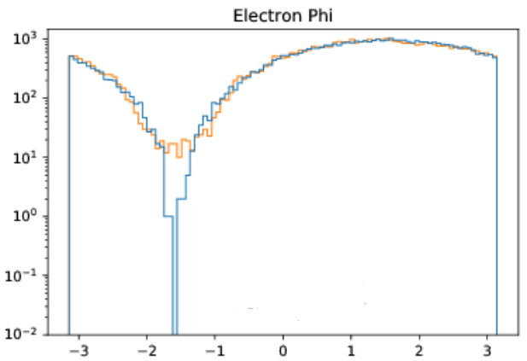
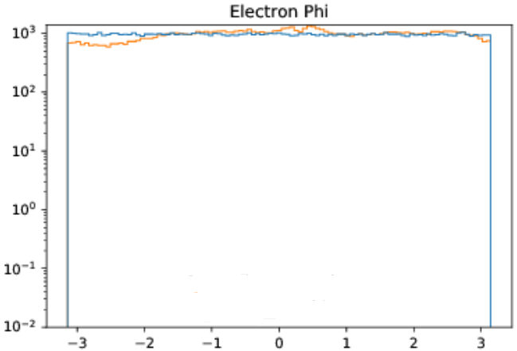
Some Preliminary Results
Recover the undistorted signals from the distorted signals under detector effects in proton-electron scattering
Distorted Signals
blue: observed distorted signal
orange: projected distorted signal
Recovered Signals
blue: ground truth signal
orange: recovered undistorted signal

Slide 31
Agenda
Characteristics of Sensor Data
1D-CNN for Sensor Data as Time Series
Sensor Data Denoising
Recover Missing Sensor Data
LiDAR and Point Cloud
Summary

Slide 32
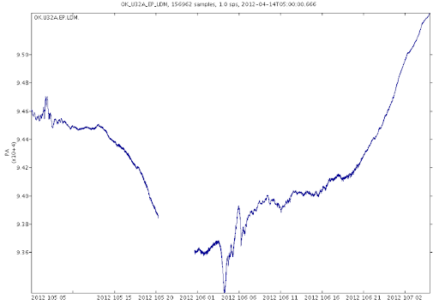

Recovering Missing Sensor Data
Missing Sensor Data
Blind spots
Severe external interference
Sensor malfunctioning
Miscommunication problem
Human errors
Out of range
“Eaten by a bear”
Sometimes, missing sensor data is inevitable
Gaps in the atmosphere measurements are due to interference of the telemetry caused by the severe weather
http://www.usarray.org/researchers/obs/transportable/atmospheric

Slide 33
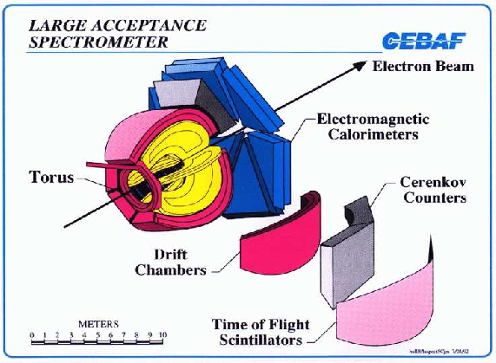
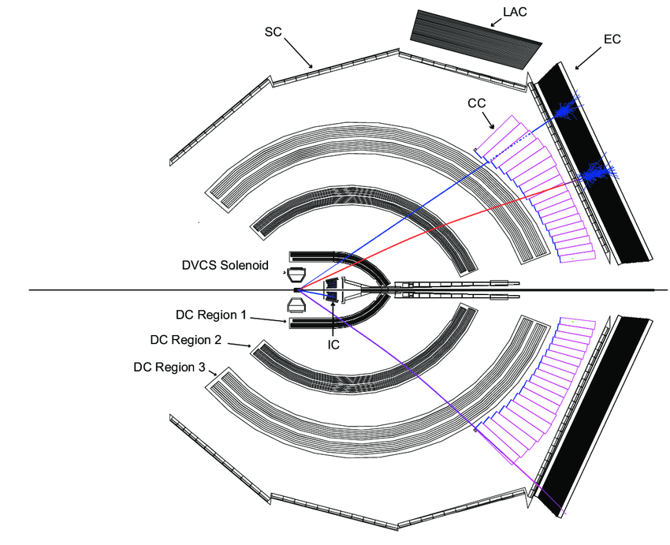
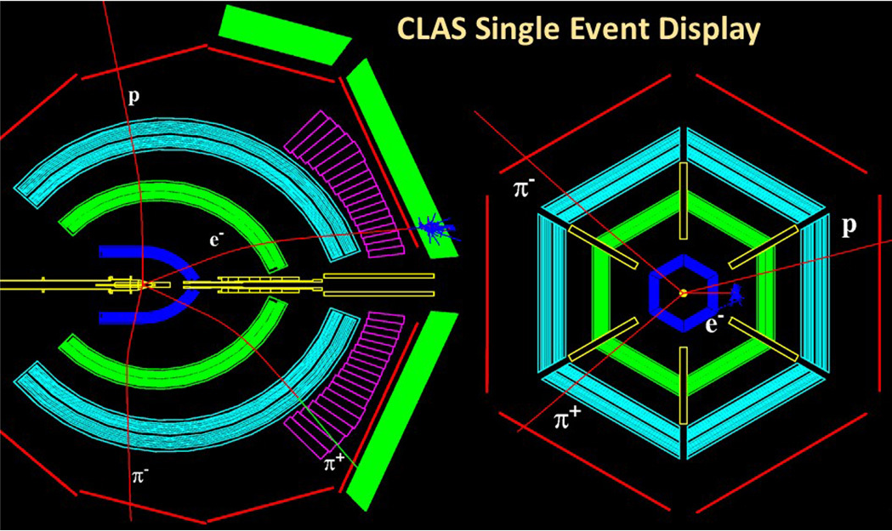
Holes in Observations
Large Acceptance Spectrometer
Each sector of CLAS is separated by torus magnet coils
Nothing can be detected in these regions
Events will slip through cracks

Slide 34
Recover the Missing Detector Data
GAN-based Sensor Event Generator
Sensor Data Filter
Simulate Detector Effects
Events falling into the crack will be filtered

Slide 35
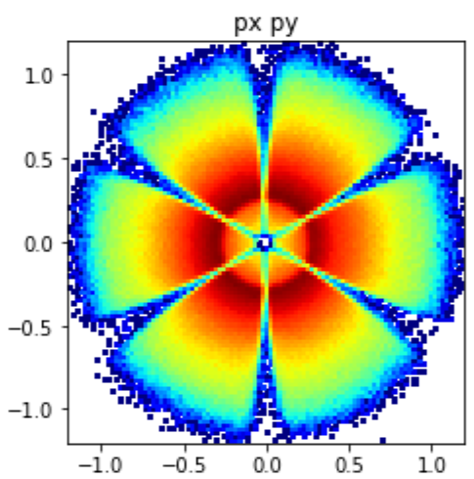
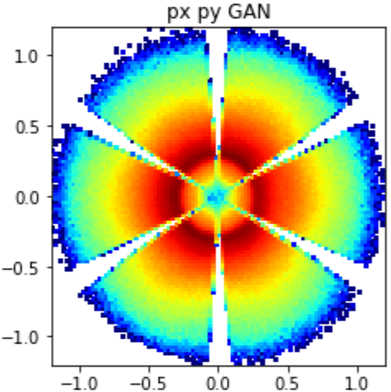
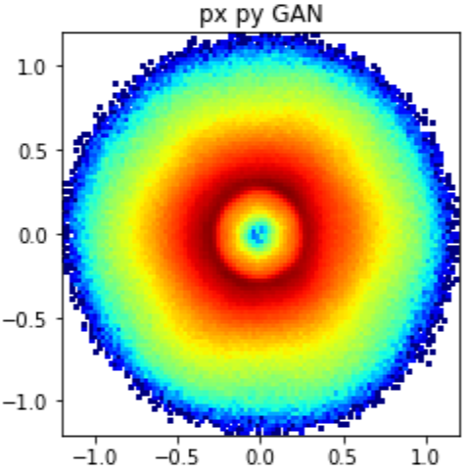
Preliminary Results
Recover the missing events disappeared in the crack
Experimental Data

Slide 36
Agenda
Characteristics of Sensor Data
1D-CNN for Sensor Data as Time Series
Sensor Data Denoising
Recover Missing Sensor Data
LiDAR and Point Cloud
Summary

Slide 37
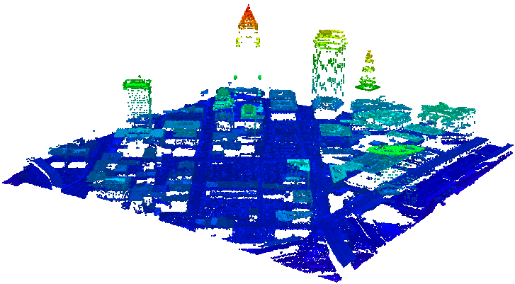
LiDAR Remote Sensing
LiDAR (light detection and ranging)
Optical remote-sensing
LiDAR scan
Uses laser light to densely sample object surface
Produces point cloud data
Highly accurate (x, y, z) measurements

Slide 38
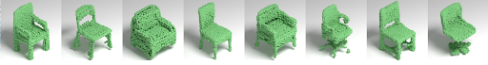
Point Cloud
Point Cloud
A collection of points representing a 3D shape
Coordinate of each point (X, Y, Z)
Points together representing certain Features

Slide 39
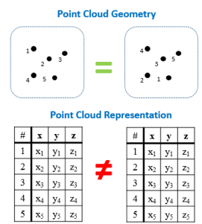
Machine Learning on Point Cloud Data
Tasks
Classification
Segmentation
Challenge
Points are orderless

Slide 40
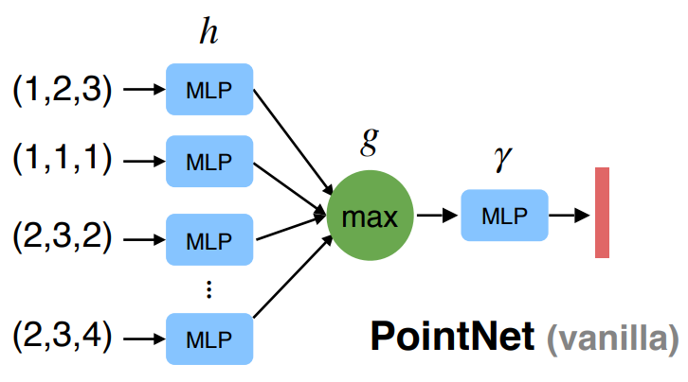
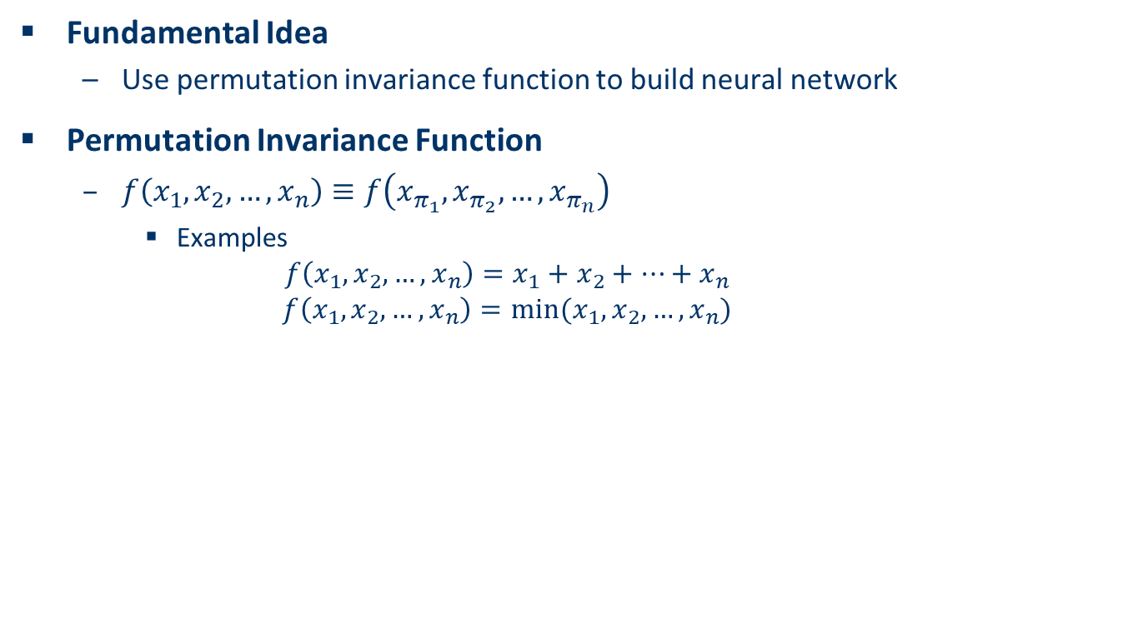
PointNet
Fundamental Idea
Use permutation invariance function to build neural network
Permutation Invariance Function
$f\left(x_{1},x_{2},…,x_{n}\right)≡f\left(x_{π_{1}},x_{π_{2}},…,x_{π_{n}}\right)$
Examples
$$f\left(x_{1},x_{2},…,x_{n}\right)=x_{1}+x_{2}+…+x_{n}$$
$$f\left(x_{1},x_{2},…,x_{n}\right)=min⁡(x_{1},x_{2},…,x_{n})$$
Charles R. Qi, Hao Su, Kaichun Mo, Leonidas J. Guibas, PointNet: Deep Learning on Point Sets for 3D Classification and Segmentation, CVPR, 2017.

Slide 41
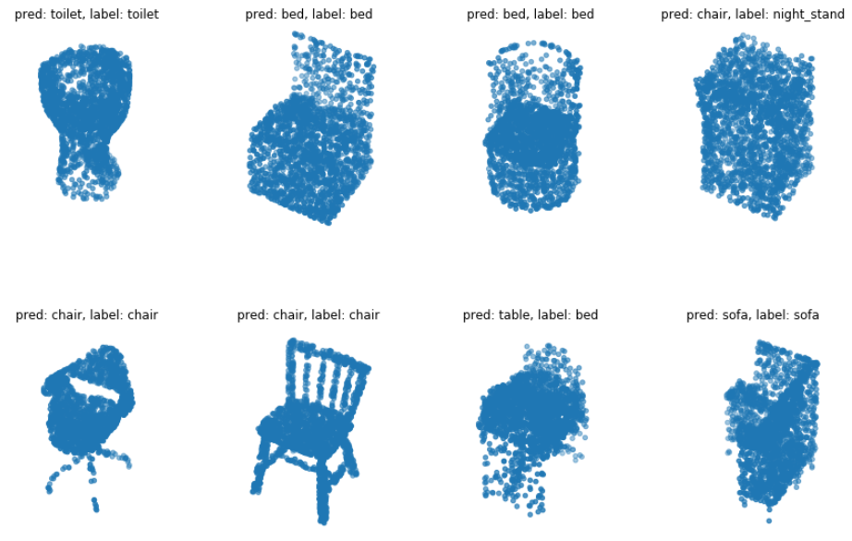
Demo: Point Cloud Classification
Jupyter notebook pointnet.ipynb

Slide 42
Summary
Machine Learning for Sensor Data Analysis
Classification
Prediction/Forecast
Denoising
Recovering missing data
Segmentation
Feature Selection/Extraction
Data Mining
Super-resolution
Outlier Detection
Semantic annotation

